Slide 1

NATIONAL UNIVERSITY OF COMPUTER AND EMERGING SCIENCES – FAST NUCES
MS Thesis I Defense
Real-Time Detection and Prediction of Zero-Day Attacks in Network Traffic Using Ensemble Unsupervised Learning
DEPARTMENT OF CYBER SECURITY
Supervised By
Asst. Prof. Dr. Fahad Samad
Made By
Kanwar Azlan (23K-7709)

Slide 2

INTRODUCTION
Zero day attack detection is still an open challenge to the researchers as it is evolving like a snow ball. Most importantly zero day has an edge from other network attacks as it remains undetected until an attacker made the exploitation [3].
Researchers are widely using ML techniques and algorithms to predict the zero day attacks. Yet there is still some gaps for the attacker to evade [3].
As per the recent literature, we concluded that unsupervised or META Unsupervised learning approach is best for unknown attacks. Also, we are using Ensemble learning approach to cater a wider range of positive results [3].
Our approach is to first replicate the findings from the research paper and analyze the prediction results and after, developing our own methodology to have better efficiency of prediction results in hand. The main purposes are:
Detecting zero day attacks
Using Unsupervised learning framework
Ensemble learning approach
Efficient use of dataset

Slide 3

PROBLEM STATEMENT
The proposed interaction graph analysis heavily relies on interaction patterns between flows for predicting zero day attacks which is not a good approach as many patterns have abnormal behavior and are not certainly sophisticated. Also this is an open door to the type of attacks which mimic the normal traffic flow behavior. [2]

Slide 4
LITERATURE REVIEW
IDEA | RESEARCH GAP | METHODOLOGY | TECHNOLOGY | LIMITATIONS | MITIGATIONS | YEAR
A Review of ML based zero day detection. | Signature based detections | Comparison of different ML models to predict | SL, UN SL, DL models and other ML models. | Zero day attack Dataset is limited. | Honeypots can be used to gain better dataset for prediction. | 2023
Comparison of SL, UN SL, META Learning Models. | Traditional models face difficulty in detecting zero day attacks. | Tried Different classifiers of ML models on different type of dataset. | ML models 47 classifiers on 11 public dataset. | SL, META SL, are not effective in detecting zero day attacks. | META UN SL can be used as the future direction. | 2023
Federated graph neural network for anomaly detection in CAN | Existing CAN bus lack real time performance. | Generated directed graph for CAN message, Node attributes denote data contents, then make predictions | Federated learning approach, Graph neural network (GNN) | injecting poisoning data or uploading poisoning local models during model training. | Can detect multi-stages attack types in CAN messages | 2023
Flow interaction graph analysis | DL based model used, graph dependent on network patterns | Real time graph generation, categorize them based on Ml models for detecting unknown attacks | GNN, Deep learning models. | Dependencies on network patterns, Effective Model but not optimal solution used. | GNN based approach to detect unknown attacks from analyzing network patterns | 2024

Slide 5
LITERATURE REVIEW Cont.
IDEA | RESEARCH GAP | METHODOLOGY | TECHNOLOGY | LIMITATIONS | MITIGATIONS | YEAR
Fine grained unknown class detection against open set attacks | Previous models cannot detect anomaly type. | Splitting the data, then leveraging the concept of isolation, advancing the incremental model to cope up with network traffic. | Novel Tree based Model, Supervised Learning | Suffers with large number of data, The scheme should be customized for every user. | FOSS identified known and unknown attacks to legitimate traffic in incremental model. | 2024
Network based anomaly detection using GRU | DL models suffers real time detection, availability of data. | Improve the data in training, Used GRU NN for better accuracy. | SMOTE Algorithm, GRU, NN, DL models. | Greater false alarm rate. High processing power | Provide technique for detecting VANET network traffic anomalies. | 2024
Mitigating poisoning attacks in Semi-supervised learning | False data patterns, sample dependencies, noisy data. | Feature extraction, poisoning attack impact estimation, detect anomalies with clustering algorithms | gradient descent algorithm, DL based models, VRNN | The complexity of the PRAD based approach is still questionable. | PRAD framework for detecting encrypted traffic anomalies. | 2024
Unsupervised anomaly detection for network security | False positive, no prior info, anomaly patterns | Flow generation, feature extraction, anomaly detection then experiment to validate. | MSC, K-means++ Apriori, random projections, Unsupervised Modes | Depending on IP address of network in packet info, More scalability and reliability | Used unsupervised learning MSCA to increase robustness of detection by multiple independent results | 2023

Slide 6

RESEARCH GAP
Graph analysis framework which is a deep learning model was used which makes the model less accurate in comparison of unsupervised learning.
Existing encrypted traffic detection methods uses supervised learning which is based on prior knowledge. (e.g. labeled dataset).
Research Questions:
How the interaction graph analysis provide detailed accuracy and efficiency in network traffic analysis?
What measure can be made to enhance the accuracy for the real-time network traffic detection for unknown attacks?
Can other unsupervised ML models improve the overall detection performance of the network traffic?
Unlike a single Graph analysis framework, can ensemble learning approach be more effective in detecting unknown attack results?

Slide 7
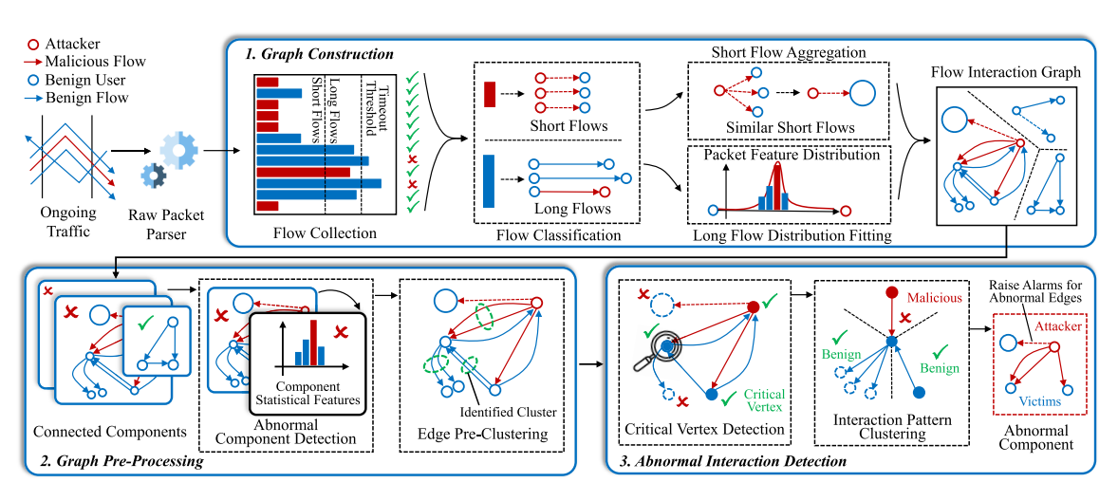
RESEARCH GAP
FLOW INTERACTION GRAPH ANALYSIS FRAMEWORK:
Source: Chuanpu Fu , Qi Li , Senior Member, IEEE, and Ke Xu , Fellow, IEEE, Member. 2024 .The overview of hyper Vision.
https://ieeexplore.ieee.org/document/10474390/figures#figures
Figure 1 The Overview of hyper vision

Slide 8
RESEARCH GAP
FLOW INTERACTION GRAPH ANALYSIS FRAMEWORK:
Limitations of graph analysis framework:
Reliance on thread interaction graph:
While effective for thread interaction models, HyperVision’s reliance on graph-based techniques can miss attacks with highly dynamic traffic patterns or subtle changes that are not easily reflected in the graph structure.
Mimic the traffic patterns:
Hyper vision relies on network traffic patterns that can be easily mimic the behavior of the network by the attacker, can be resulting in high false positive rate.
Dataset Restriction:
The dataset used mainly represents core traffic and simulated attacks in a VPC, which may limit the generalization of the model to other types of environments, such as Industrial Control Systems (ICS), IoT networks, or mobile networks.

Slide 9
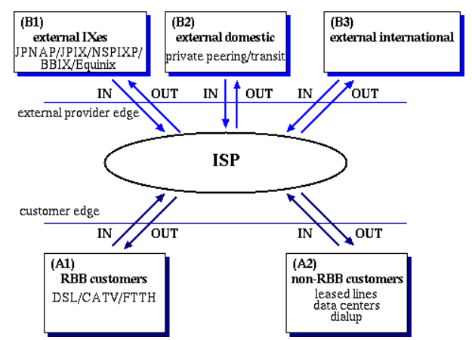
DATASET
NETWORK TRAFFIC DATASET
ISP Backbone Traffic In Japan From MAWI
This Dataset has been recently collected by August 2024, On Traffic Volume crossing ISP Boundaries. It contains Monthly average rates of aggregated customer and external traffic (bps).
The Same kind of Dataset was used for the flow interaction graph of ISP backbone traffic in Japan from January 2020.
Reference: https://mawi.wide.ad.jp/jp-traffic/data/
Figure 2 ISP Backbone Traffic Dataset

Slide 10
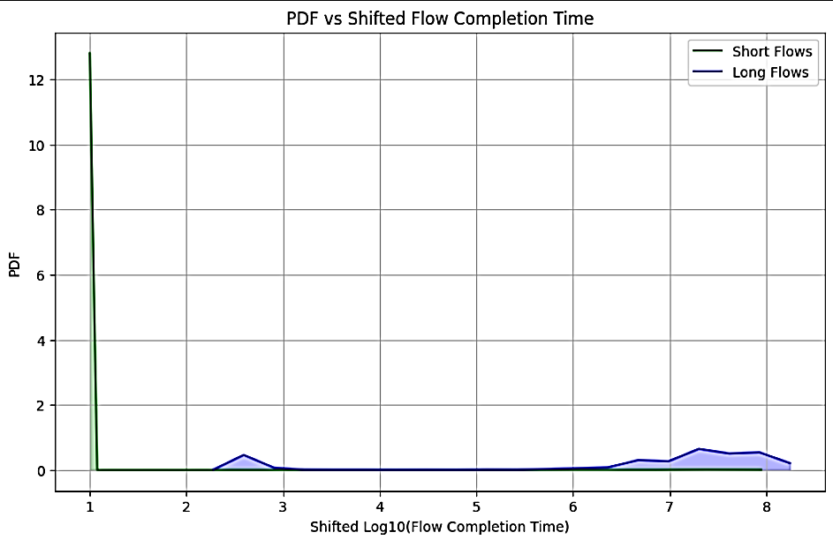
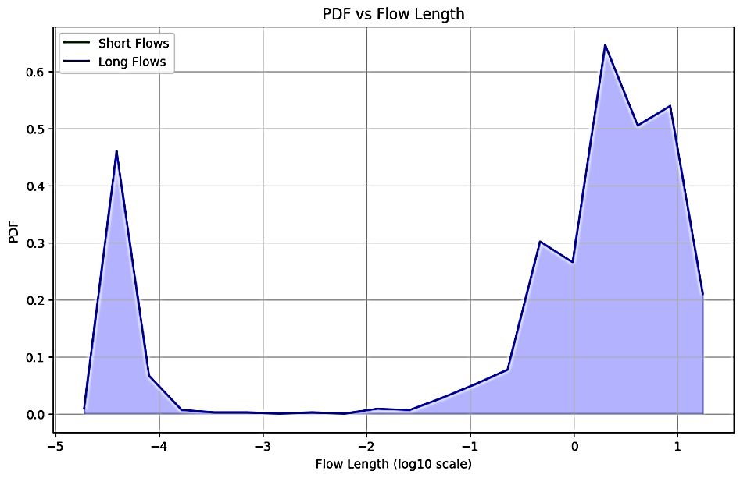
EXISTING METHODOLOGY RESULTS
GRAPH CONSTRUCTION
Flow Classification
Figure 1(a) Shows the short and long flows. With respect to Flow completion time (FCT) and Probability Density function (PDF)
Figure 1(b) Shows the short and long flows. With respect to Flow Length and Probability Density function (PDF)

Slide 11
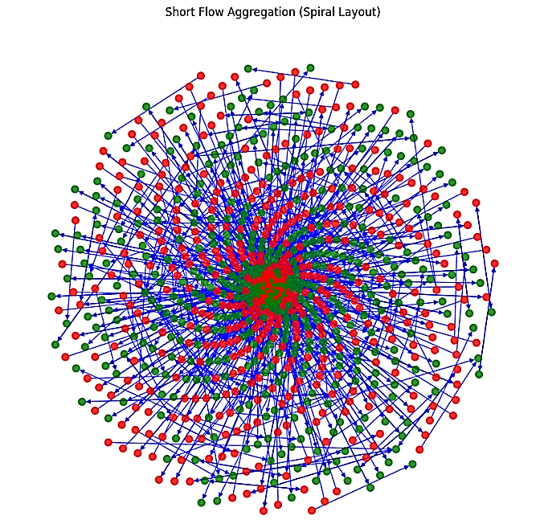
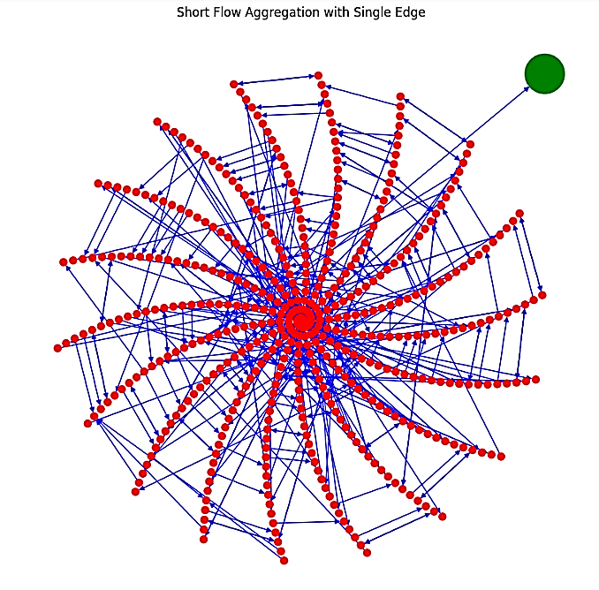
EXISTING METHODOLOGY RESULTS
GRAPH CONSTRUCTION
Short Flow Aggregation
Figure 2(a) Traditional flow as edges and have high amount of density
Figure 2(b) Density reduction and short flow aggregation

Slide 12
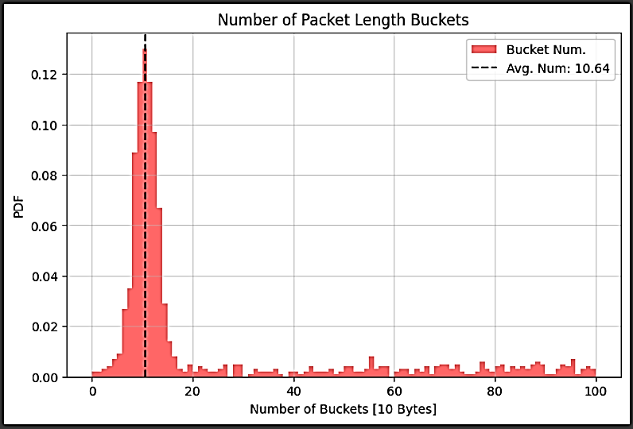
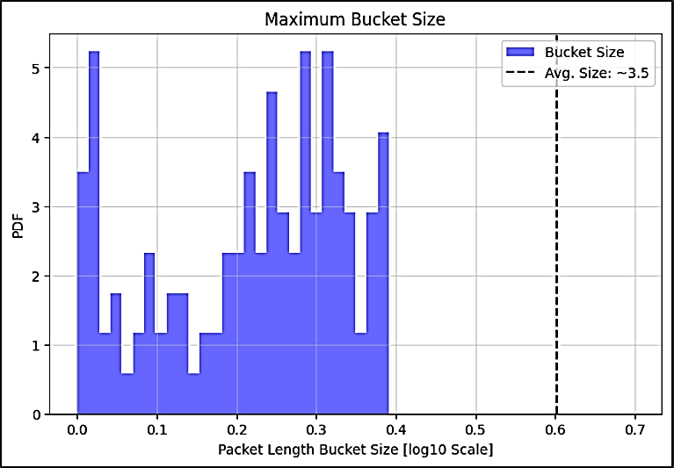
EXISTING METHODOLOGY RESULTS
GRAPH CONSTRUCTION
Feature distribution for long flows
Figure 3(a) Compare the number of buckets with number of packet length buckets.
Figure 3(b) Compare the Maximum number of buckets with number of packet length buckets.

Slide 13
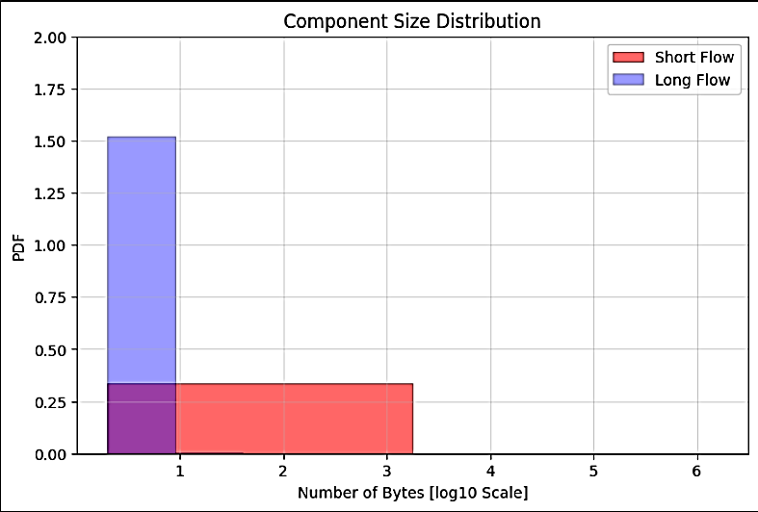
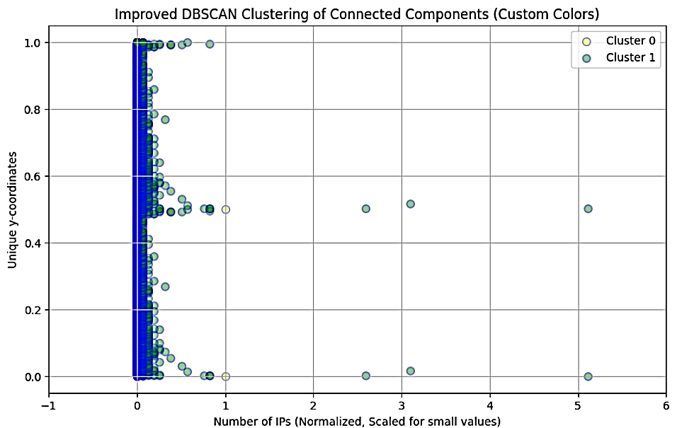
EXISTING METHODOLOGY RESULTS
GRAPH PREPROCESSING
Connectivity Analysis
Figure 4(a) defines the component size distribution for connected components of short and long flows.
Figure 4(b) illustrates that the high level pre clustering performed on the similar edges of the components.

Slide 14
PROPOSED METHODOLOGY
We are proposing ensemble learning approach to overcome the Previous research gaps for predicting zero day attacks on encrypted network traffic. Below are the detailed steps:
First we will gather the dataset of the encrypted network traffic which includes meta data, network packets and relevant features and attributes.
Now we will preprocess our dataset. It is crucial part of the proposed methodology as it removes noise, outliers and normalize the dataset.
Then we will pass the dataset without labeling to the Unsupervised ML model (K-Means , Isolation Forest and FAST ABOD) to detect and predict the unknown attacks.
Then finally we compare the results of multiple Unsupervised ML models used so that we can detect and predict the zero day with more accuracy and efficiency.

Slide 15
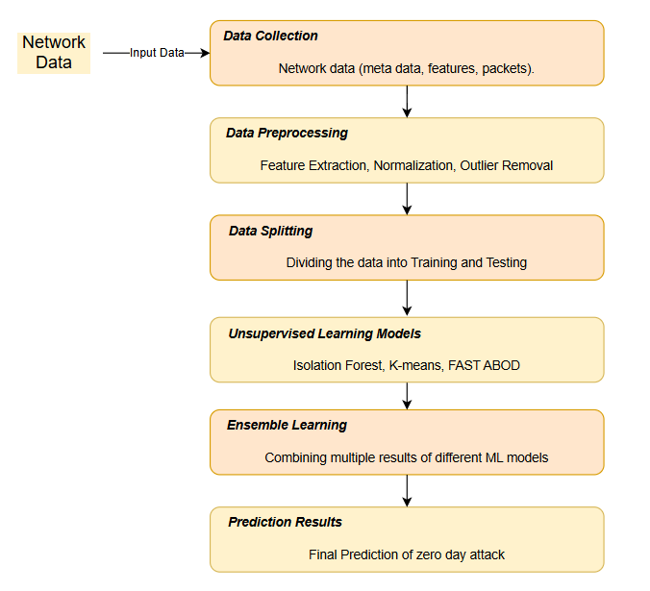
ARCHITECTURAL DIAGRAM
Figure 5. Architectural diagram

Slide 16
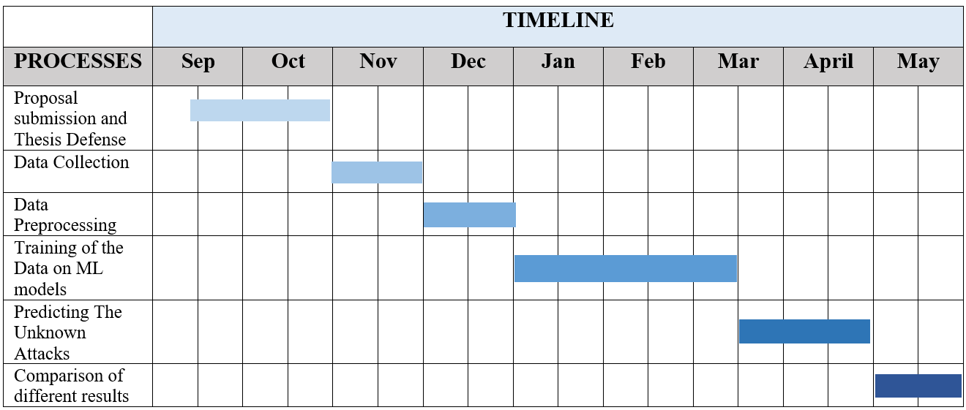
PROJECT TIMELINE
The Tentative Project timeline is shown below:
Table 1 Project Timeline

Slide 17
REFERENCES
[1] Yang Guo, computer communications, A Review of Machine Learning-Based Zero-Day Attack Detection: Challenges and Future Directions , 2023.
[2] Chuanpu Fu , Qi Li , Senior Member, IEEE, and Ke Xu , Fellow, IEEE, Member, ACM, IEEE/ACM TRANSACTIONS ON NETWORKING, Flow Interaction Graph Analysis: Unknown Encrypted Malicious Traffic Detection 2024.
[3] Tommaso Zoppi∗ , Andrea Ceccarelli, Tommaso Puccetti, Andrea Bondavalli, Computers & Security, Which algorithm can detect unknown attacks? Comparison of supervised, unsupervised and meta-learning algorithms for intrusion detection, 2023.
[4] EVA PAPADOGIANNAKI, SOTIRIS IOANNIDIS, ACM Computing Surveys, A Survey on Encrypted Network Traffic Analysis Applications, Techniques, and Countermeasures, 2021.
[5] Bizhu Wang , Yan Sun , and Xiaodong Xu , Senior Member, IEEE, IEEE INTERNET OF THINGS JOURNAL, A Scalable and Energy-Efficient Anomaly Detection Scheme in Wireless SDN-Based mMTC Networks for IoT, 2021.
[6] Ruoyu Li , Qing Li , Member, IEEE, Jianer Zhou, and Yong Jiang , Member, IEEE, IEEE INTERNET OF THINGS JOURNAL, ADRIoT: An Edge-Assisted Anomaly Detection Framework Against IoT-Based Network Attacks, 2022.
[7] Ke He , Dan Dongseong Kim , and Muhammad Rizwan Asghar, IEEE COMMUNICATIONS SURVEYS & TUTORIALS, Adversarial Machine Learning for Network Intrusion Detection Systems: A Comprehensive Survey, 2023.
[8] Sangjun Kim and Kyung-Joon Park , Applied Sciences, A Survey on Machine-Learning Based Security Design for Cyber-Physical Systems, 2021.
[9] Willian Tessaro Lunardi , Member, IEEE, Martin Andreoni Lopez , Member, IEEE, and Jean-Pierre Giacalone, IEEE TRANSACTIONS ON NETWORK AND SERVICE MANAGEMENT, ARCADE: Adversarially Regularized Convolutional Autoencoder for Network Anomaly Detection, 2023.
[10] Diego Madariaga , Graduate Student Member, IEEE, Javier Madariaga, Martín Panza, Javier Bustos-Jiménez , and Benjamin Bustos, IEEE TRANSACTIONS ON NETWORK AND SERVICE MANAGEMENT, Detecting Anomalies at a TLD Name Server Based on DNS Traffic Predictions, 2021.
[11] Ghada Elbez , Member, IEEE, Klara Nahrstedt , Fellow, IEEE, and Veit Hagenmeyer , Member, IEEE, IEEE TRANSACTIONS ON SMART GRID, Early Attack Detection for Securing GOOSE Network Traffic, 2024

Slide 18
REFERENCES Cont.
[12] Qi Li , Senior Member, IEEE, Yunpeng Liu, Zhuotao Liu , Peng Zhang , and Chunhui Pang, IEEE TRANSACTIONS ON PARALLEL AND DISTRIBUTED SYSTEMS, Efficient Forwarding Anomaly Detection in Software-Defined Networks, 2021.
[13] Ramani Sagar, Rutvij Jhaveri and Carlos Borrego, Electronics, Applications in Security and Evasions in Machine Learning: A Survey , 2020.
[14] Nadia Niknami , Graduate Student Member, IEEE and Jie Wu , Fellow, IEEE, IEEE TRANSACTIONS ON NETWORK SCIENCE AND ENGINEERING, Entropy-KL-ML:Enhancing the Entropy-KL-Based Anomaly Detection on Software-Defined Networks, 2022.
[15] Hengrun Zhang , Member, IEEE, Kai Zeng , Member, IEEE, and Shuai Lin, Member, IEEE, IEEE TRANSACTIONS ON INFORMATION FORENSICS AND SECURITY, Federated Graph Neural Network for Fast Anomaly Detection in Controller Area Networks, 2023.
[16] Ziming Zhao , Student Member, IEEE, IEEE/ACM TRANSACTIONS ON NETWORKING, FOSS: Towards Fine-Grained Unknown Class Detection Against the Open-Set Attack Spectrum With Variable Legitimate Traffic, 2024.
[17] Yating Liu, Student Member, IEEE, Yuantao Gu , Senior Member, IEEE, IEEE TRANSACTIONS ON NETWORK SCIENCE AND ENGINEERING, MSCA: An Unsupervised Anomaly Detection System for Network Security in Backbone Network, 2023.
[18] Zhangfa Wu , Huifang Li , Yekui Qian , Yi Hua , and Hongping Gan , Member, IEEE, IEEE TRANSACTIONS ON NETWORK SCIENCE AND ENGINEERING, Poison-Resilient Anomaly Detection: Mitigating Poisoning Attacks in Semi-Supervised Encrypted Traffic Anomaly Detection, 2024.
[19] Ying Zhong , Zhiliang Wang , Xingang Shi, IEEE TRANSACTIONS ON INFORMATION FORENSICS AND SECURITY, RFG-HELAD: A Robust Fine-Grained Network Traffic Anomaly Detection Model Based on Heterogeneous Ensemble Learning, 2024.
[20] Rasheed Ahmad1 · Izzat Alsmadi2 · Wasim Alhamdani1 · Lo’ai Tawalbeh3, Zero‑day attack detection: a systematic literature review, 2023.
[21] WIDE. MAWI Working Group Traffic Archive. Accessed: May 2022. [Online]. Available: http://mawi.wide.ad.jp/mawi/
[22] Supplementary Material. Accessed [Online]. Available: https://ieeexplore.ieee.org/ielx7/90/10640200/10474390/supp13370851.pdf?arnumber=10474390

Slide 19
Thank You !

